Slide 1
Tore Alden Principal Analyst The Jacobsen
Vegetable Oil Price Risk –
Summer 2022
Notes:
Journey of transformation
Introductions to co presenters
Housekeeping & phones

Slide 2
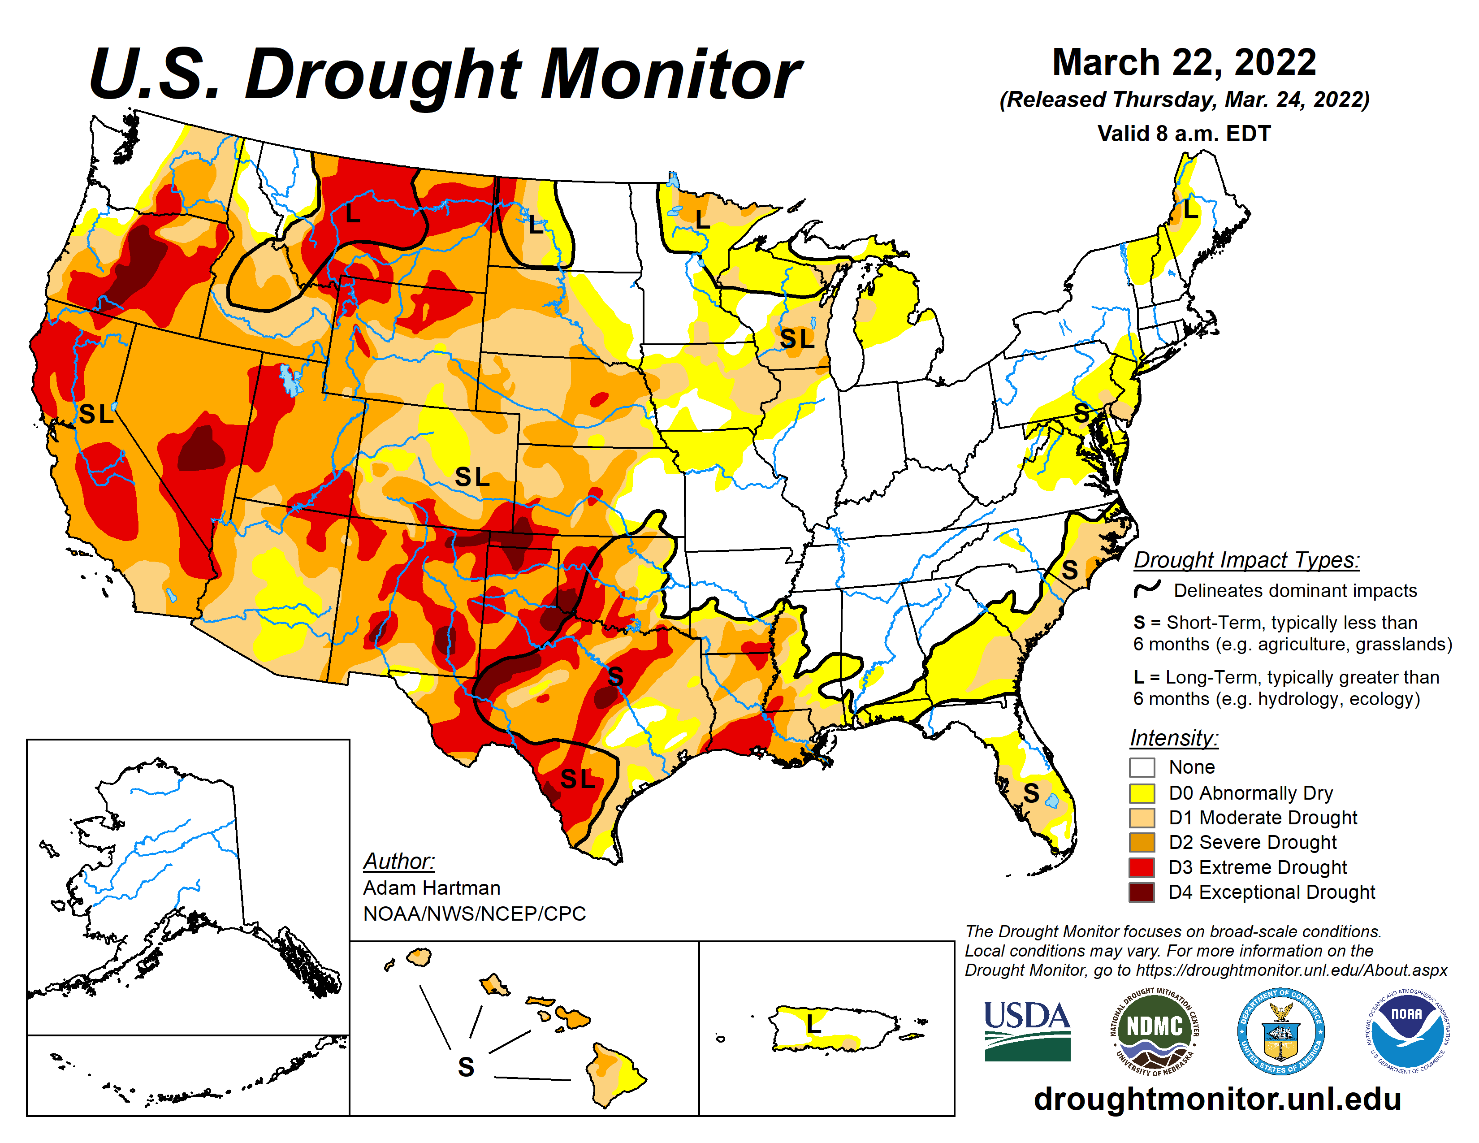
The U.S. enters the growing season with a multi-year drought over much of the western half of the country.
Spring rainfall will likely replenish soil moisture levels in the Corn Belt.
If the drought expands eastward, it will have a significant impact on some of the largest soybean/canola producing regions of the country.
Fastmarkets | Agricultural Forecasting

Slide 3
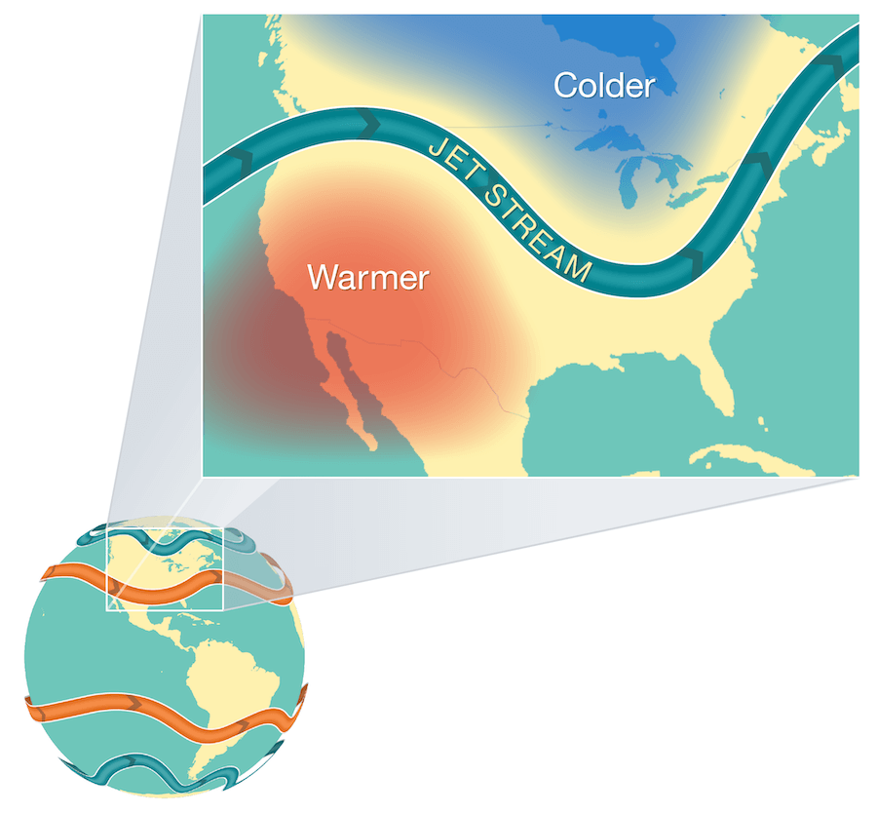
A combination of a long-duration La Niña and negative PDO could shift the jet stream eastward.
Rainfall generally occurs where hot unstable weather meets colder air.
Even if the jet stream shifts westward, it is more difficult to generate rainfall over drought stricken areas.
Fastmarkets | Agricultural Forecasting

Slide 4
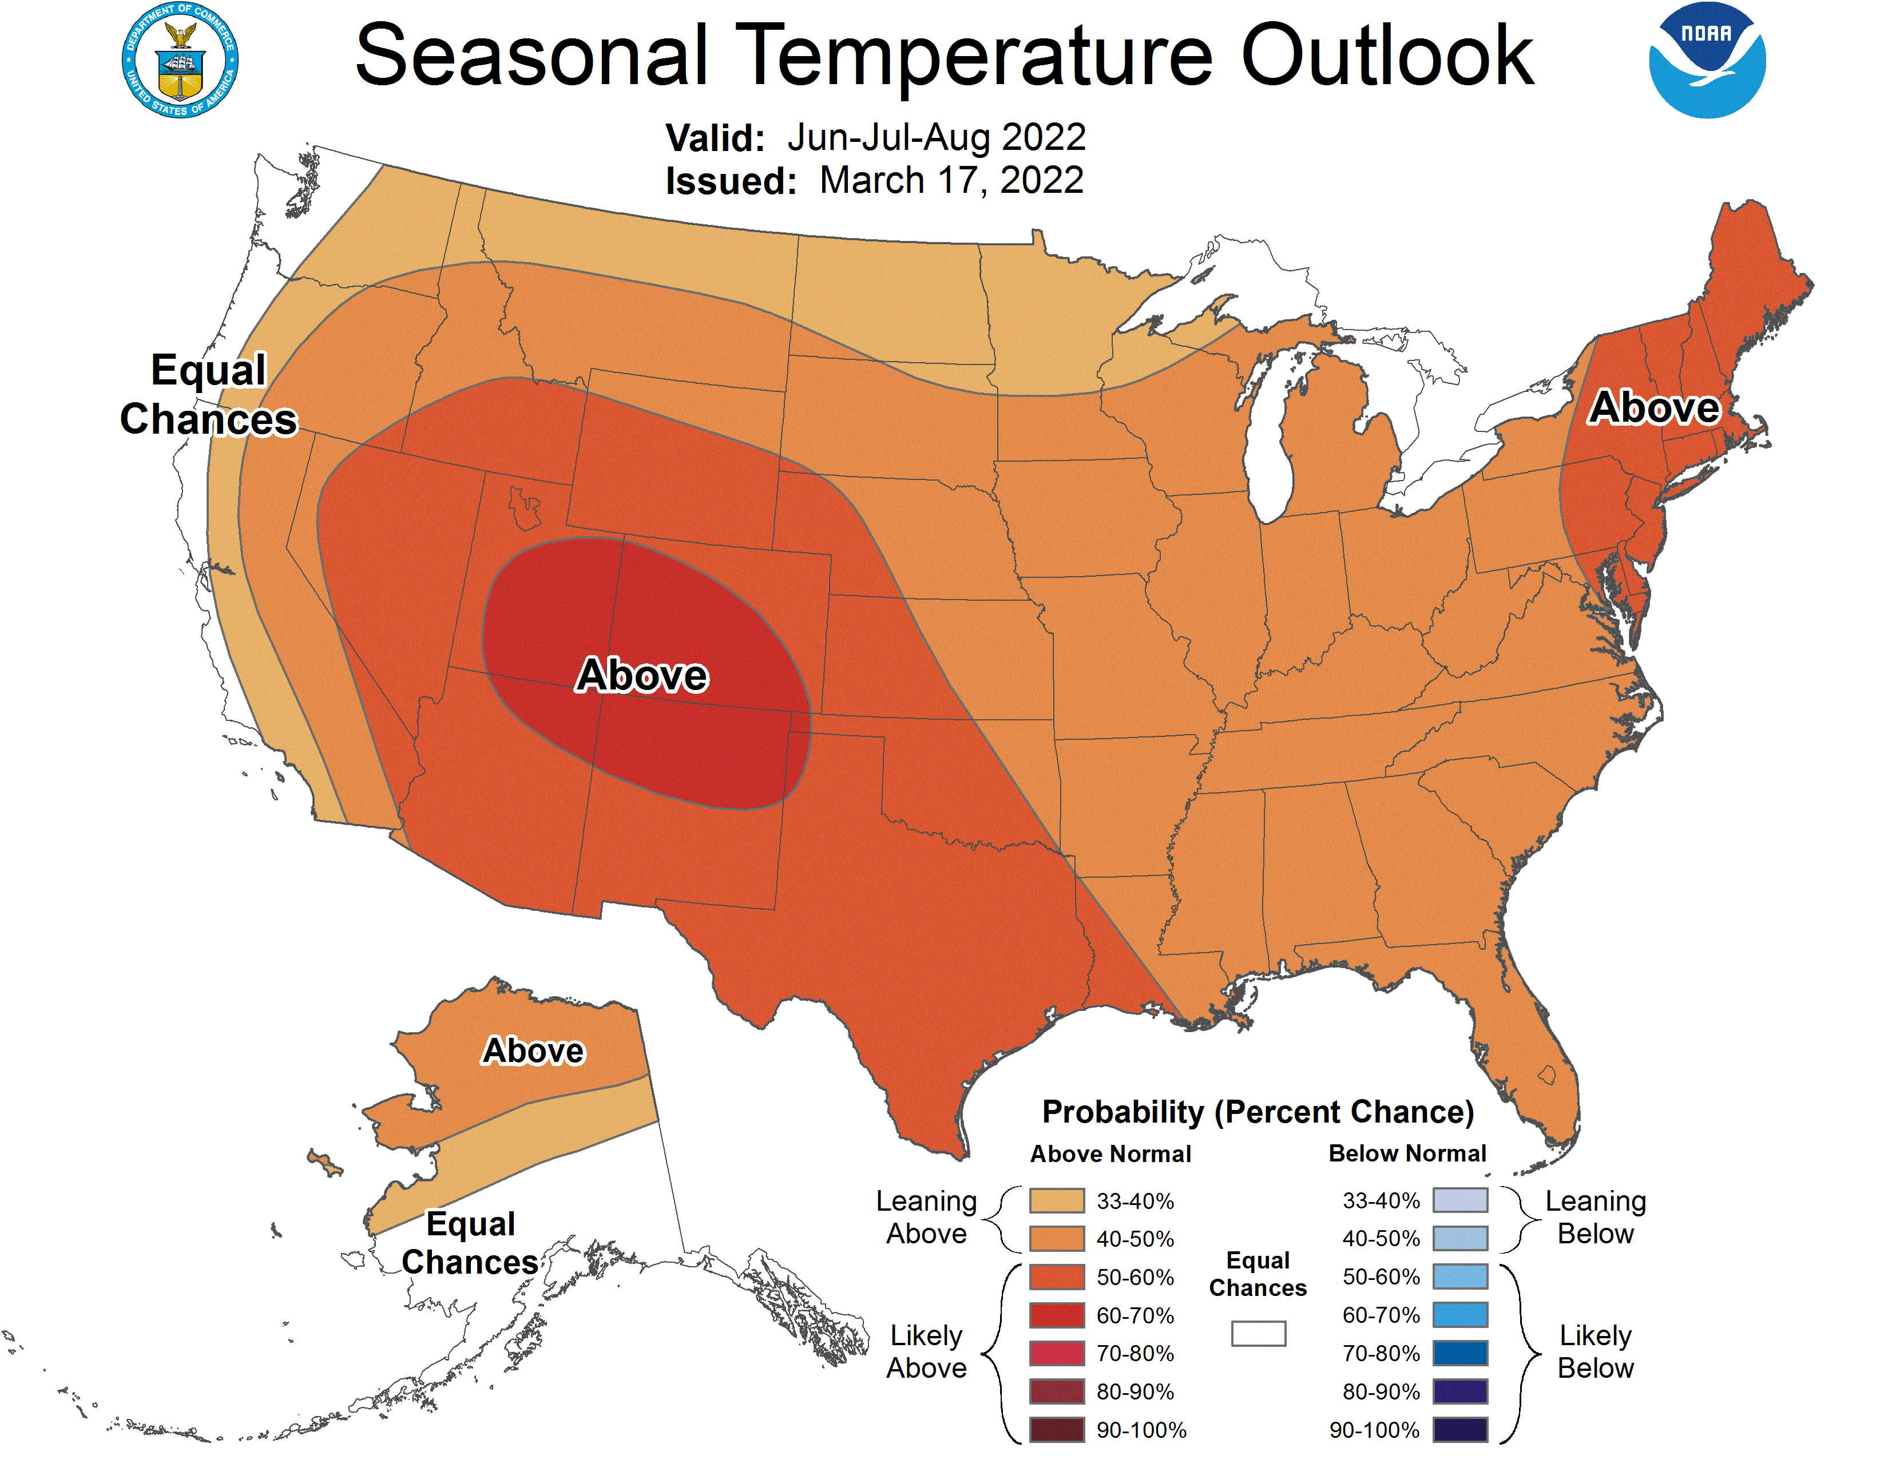
NOAA expects summer temperatures to be above normal across most of the country.
A shift in the jet stream eastward would shift the greater chances for above average temperatures into the Western Corn Belt.
Fastmarkets | Agricultural Forecasting

Slide 5
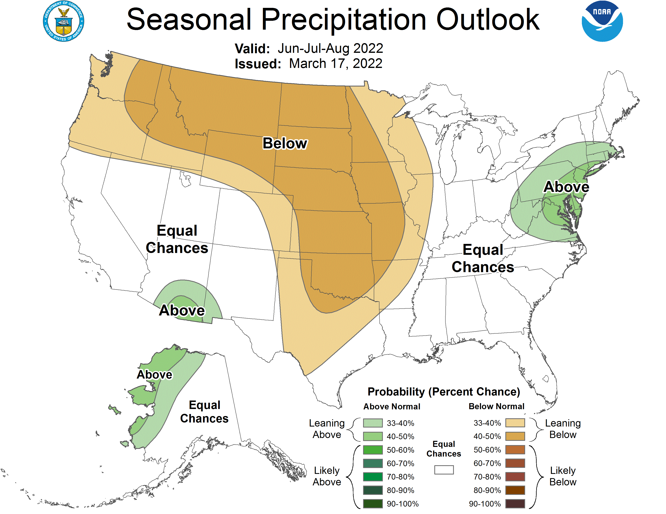
NOAA expects drought to continue in canola growing regions of the U.S. and Canada.
Below normal rainfall during August in Iowa would substantially reduce U.S. soybean yields.
NOAA’s Spring Outlook predicts drought will continue or worsen in much of the Western Corn Belt and Mississippi Delta during the spring, increasing the need for summer rainfall.
Fastmarkets | Agricultural Forecasting

Slide 6
Expectations for U.S. soybean planted area range from 86 to 92.2 million acres with an average of 88.9.
Based on The Jacobsen’s demand forecasts and 2021/22 ending stocks forecast, demand rationing is likely to occur if acreage is smaller than the average guess or the average yield falls below 50 bushels per acre.
Fastmarkets | Agricultural Forecasting

Slide 7
The Jacobsen projects the average price for the November contract in October will be about $16 per bushel, without demand rationing.
If the yield falls below the trend line, The Jacobsen would predict significantly higher prices.
Fastmarkets | Agricultural Forecasting

Slide 8
The price of soybeans accounts for about 85 percent of the price of soybean oil.
While the $16 projection for November soybeans implies a soybean oil price above 60 cents, the upside risk is much greater than in an average year.
Over the last year, the price relationship has skewed above the trendline, suggesting greater upside risk.
Fastmarkets | Agricultural Forecasting

